Slide 1


One Time Close for
Correspondent Lending
February 2026
Version 1.0

Slide 2
GMFS
Exclusive Opportunity for select Partners
This is a unique product only offered to select Correspondent clients. Loans must be closed, modified and documents recorded from the construction period to permanent prior to purchase from GMFS. This guide is a supplement to the GMFS Correspondent Client Guide. You will not find reference to this program under GMFS Overlay and Policy guide or Eligibility Matrix. All standard Overlays apply unless description below guides otherwise.
There are three different options GMFS offers for Correspondent clients with varying degrees of involvement and responsibilities for both the Correspondent Client and GMFS.
02

Slide 3
Overview
01

Slide 4

One Time Close Construction Loan (OTC)
The One Time Close Construction Loan (OTC) will be underwritten by GMFS after the loan has been submitted by the correspondent. A conditional approval will be issued listing conditions that will need to be met at modification. Upon the conditional approval, the GMFS Closing Department will produce the loan documents in the correspondent’s name and deliver to the designated title company for the loan closing. The correspondent will manage either themselves, or through a 3rd party servicer the construction draw process during construction. Upon completion of the home, the correspondent will re-submit the loan to GMFS underwriting with the conditions listed on the initial approval. GMFS will then underwrite the loan and issue an approval for modification and then produce the modification documents to the correspondent lender. Upon execution and recordation of the modification documents, the correspondent will deliver the loan to GMFS for purchase.

Slide 5
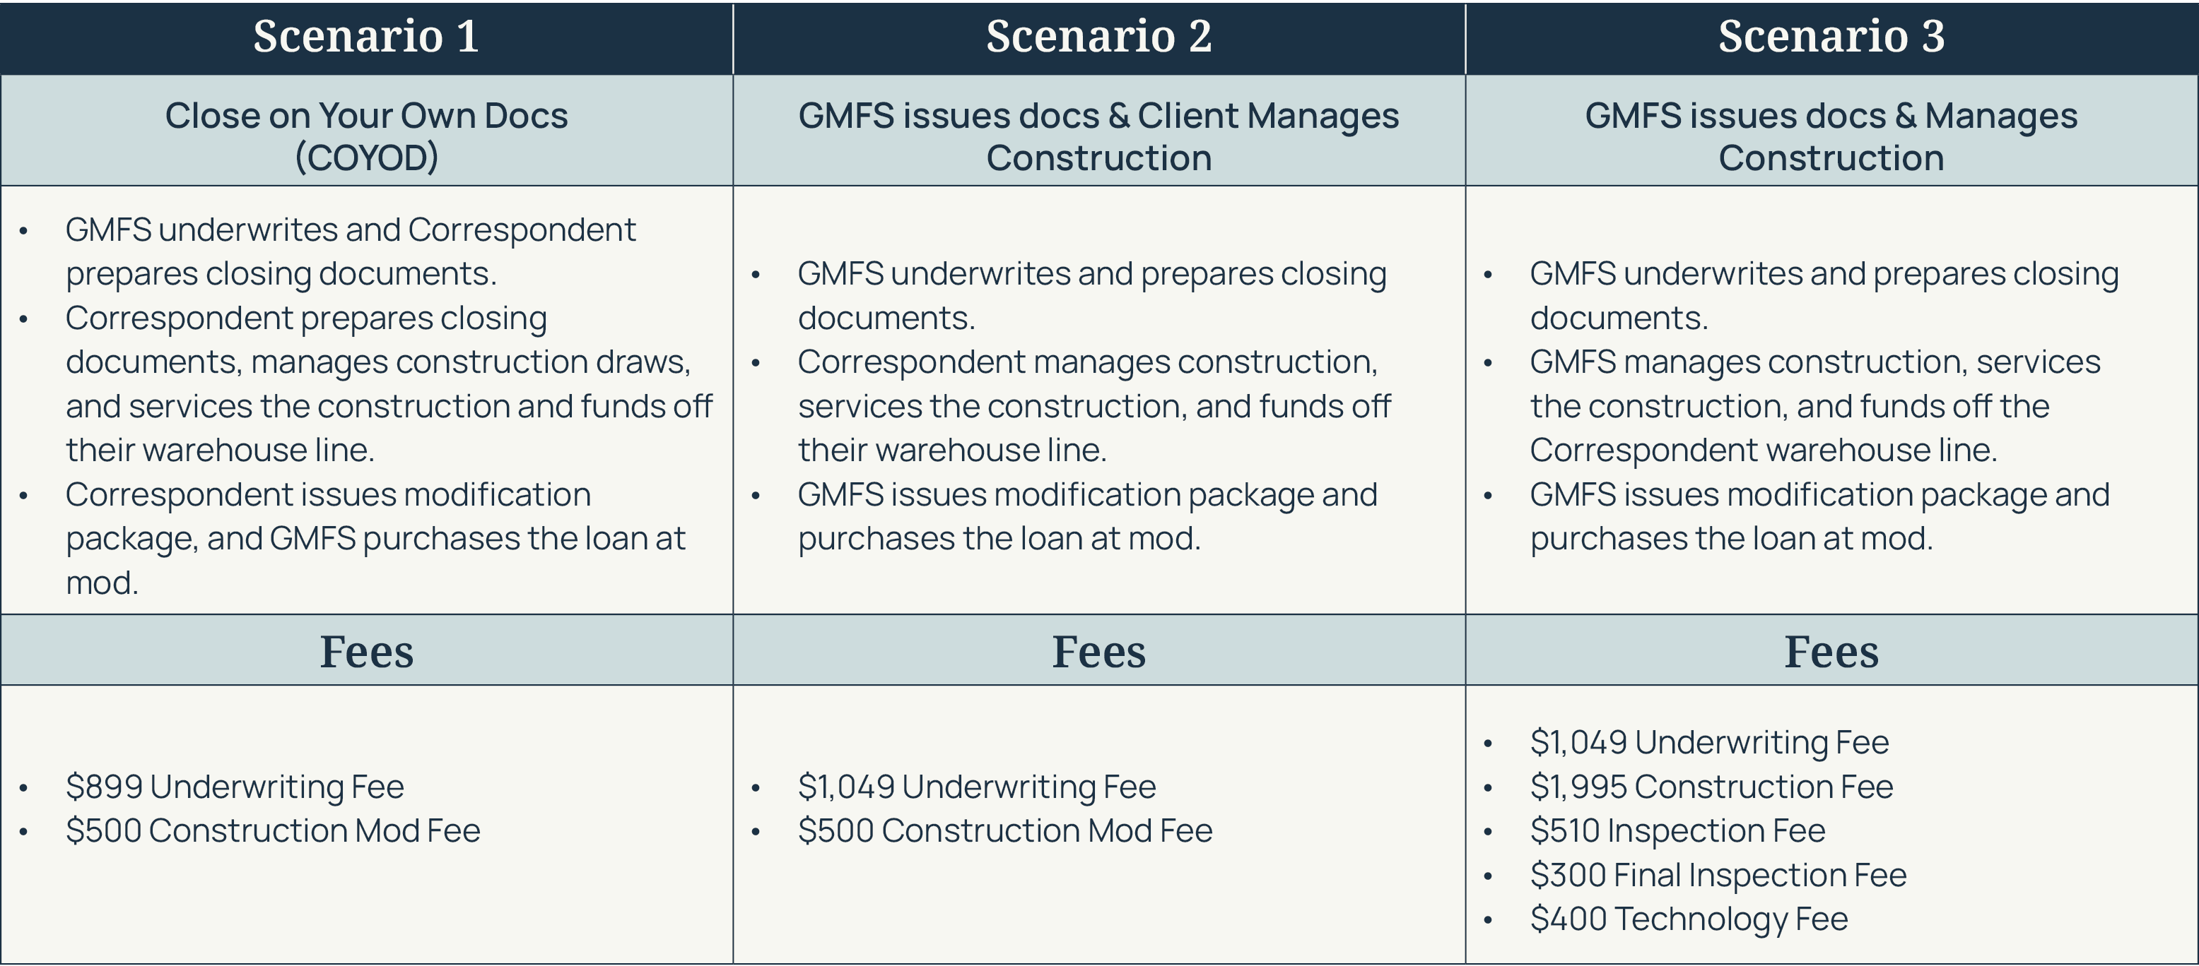
Choose the Scenario that works for you

Slide 6
GMFS
DISCLOSURES
Unless otherwise agreed upon, Correspondent will generate their own disclosures including an LE. GMFS will match the approval and closing documents to terms listed on the disclosures and will generate a CD. At modification, another CD will be generated by GMFS. The CD will need to be executed as part of the modification package.
ENCOMPASS SET UP
In Optimal Blue please identify with one of the following Program Codes:
OTC 30 yr or OTC 15 yr
OTC ARM- 5/1 ARM based on CMT (GMFS will not purchase an ARM OTC, loan must modify to a fixed rate to be eligible for purchase).
06

Slide 7
Underwriting &
Program Parameters
02

Slide 8
GMFS
TERMS
The Construction Lending Institution will need to inform GMFS of the proposed interest rate they want the loan to be underwritten at for the purpose of potentially selling the loan to GMFS upon modification of the loan. At this time, GMFS allows the borrower to modify to a Conventional 30 or Conventional 15 year loan from an ARM. The loan may not modify from a fixed rate to an ARM.
  A purchase transaction
  When a purchase transaction is used, the borrower is not the owner of the lot prior to the loan application, and the borrower is using the proceeds from the interim construction financing to purchase the lot and finance the construction of the property
  A limited cash-out refinance transaction
  When a limited cash-out refinance transaction is used, the borrower must have held legal title to the lot before he or she applied for the interim construction financing. The borrower is using the proceeds from the construction financing to pay off any existing liens on the lot and finance the construction of the property.
08

Slide 9
GMFS
Determining LTV
Purchase Transaction
  The LTV ratio is calculated by dividing the loan amount of the construction-to-permanent financing by the lesser of:
    Purchase price (sum of the cost of construction and the sales price of the lot), or
    As-completed appraised value of the property (the lot and improvements).
  Limited Cash-out Refinance Transaction
  The LTV ratio is calculated by dividing the loan amount of the construction-to-permanent financing by the as-completed appraised value of the property (the lot and improvements).
  Flood Certificates
  Correspondent to pull flood cert for initial approval of loan. GMFS will pull a final flood cert once construction is complete and loan has been re-submitted for modification approval.
Rate Lock
Loan may be locked in with GMFS once the home is near completion. Lock must cover the time it takes for the home to be completed as well as obtaining approval for the modification and delivery of the executed modification documents to GMFS for purchase. In Optimal Blue, fill out the Loan Notes section notating the loan you are locking is a construction loan that is modifying to permanent financing.
09

Slide 10
Modification
03

Slide 11
GMFS
Requalification Triggers
If any of the below are present in the loan file then a requalification will be necessary
  The oldest credit document in the loan file does exceeds 18 months from the modification date
  LTV and CLTV is greater than 95%
  Credit scores at time of initial closing is below 700.
The GMFS underwriters will condition what documents will be required at modification on the initial loan approval. In addition, the credit expiration date will appear on the UW Approval Memo. Please contact your underwriter if you have questions.
Upon notification the home is near completion, Client should contact customer to begin the modification process. If required, customer will need to requalify:
  Update income and asset documentation from client (see list below)
  Pull new credit bureau (If applicable)
  Re-run AUS (If applicable)
  Once all documentation is gathered (see items below as well), your CRR will submit all items to EDM as “Condition-New” and email the U/W for approval.
011

Slide 12
GMFS
Required Documentation for Modification Approval
Updated income and asset documentation. (Unless LTV is 95% or less and credit scores are 700 or greater and oldest credit document does not exceed 18 months from modification date)
Last two months bank statements (Unless LTV is 95% or less and credit scores are 700 or greater and oldest credit document does not exceed 18 months from modification date)
Updated credit bureau (Unless LTV is 95% or less and credit scores are 700 or greater and oldest credit document does not exceed 18 months from modification date)
Verbal VOE within 5 days of the modification (Unless LTV is 95% or less and credit scores are 700 or greater and oldest credit document does not exceed 18 months from modification date)
Final appraisal (1004D must include recertification of value)
Certificate of Occupancy
Homeowner’s insurance with paid receipt. Must be paid in full for one year.
Client orders a title update from the title company loan closed with. This update needs to be done within 30 days of the modification date.
Executed lien waiver by contractor
Client requests a payoff on the construction loan from the Construction Loan Administrator; payoff should be dated the same day as the modification.
Additional documentation may be required on a case by case basis, as determined by the underwriter.
  Lock the loan in OB as you normally would. The lock must cover the time it takes to obtain approval to modify, modify the loan and deliver to GMFS with the recorded modification. Loan must modify before the rate lock expires, or will need to be extended. YOU DO NOT NEED TO DISCLOSE AGAIN. If loan was closed with LPMI, the original pricing for LPMI must be used when locking the rate. It will be the correspondent’s responsibility to be sure the correct pricing for LPMI is used when locking the rate in OB.
  Modification CD: CD should include pre-paid interest, escrow deposit and construction loan payoff. Fees may be collected as long as they were initially disclosed on the LE prior to the loan closing.
012

Slide 13
GMFS
Lien Requirements
All construction work, including any work that could entitle a party to file a mechanics’ or materialmen’s lien, must be completed and paid for, and all mechanics’ liens, materialmen’s liens, and any other liens and claims that could become liens relating to the construction must be satisfied before the mortgage loan is delivered to Fannie Mae. The lender must retain in its individual loan file the appraiser's certificate of completion and a photograph of the completed property. When a construction-to-permanent mortgage loan provides funds for acquisition or refinancing of an unimproved lot and the construction of a residence on the lot, the lender must retain a certificate of occupancy or an equivalent form from the applicable government authority.
Upon approval to modify the loan, modification documents will be requested by the GMFS Closing Department and sent to the correspondent to execute
Documentation
A separate modification agreement must be used to convert the construction loan into permanent financing. This agreement must be executed and recorded in the applicable jurisdiction before the permanent mortgage is delivered to Fannie Mae.
An extension will be required in a scenario where the 1 Year Interest Only period would mature prior to completion of the home. The extension will move the maturity date back to allow for more time in an interest-only period.
013

Slide 14
GMFS
Required 5/1 ARM Terms
Product to read “1 Year Interest Only, 5/1 Adjustable Rate”
Rate caps must be 2/2/5
Index must be “1yr AVG Weekly CMT”. GMFS system will show UST1YW
Floor will be set to 2.75% with the floor basis set to Margin
We will select to round up to .125% and our Margin will be 2.75%
014

Slide 15
OTC Best Practices
04

Slide 16
GMFS
Best Practices for OTC
It is advised to qualify the customer at an interest rate above market to help ensure your customer’s ability to qualify for the permanent mortgage at time of build completion.
It is advised to use Fannie Mae with this product since there is the opportunity to not need to requalify at modification if FICO is 700+ at time of close. All OTC loans that close with Freddie must requalify at modification.
If loan amount is being increased during the construction period for overages, the client is advised to notify GMFS so we can ensure the customer qualifies for the increased amount.
A letter can be used from the local county stating there is not a local permitting office in a scenario where there is not a permitting office to issue a certificate of occupancy.
016

Slide 17
Correspondent OTC
Flow Chart
05

Slide 18
GMFS
GMFS prepares closing docs (not applicable for Texas Clients)
Step | Stage / Action | Notes / Responsibility
1 | GMFS prepares closing docs | Not applicable for Texas clients
2 | Client uploads loan package docs + submission cover sheet | Client action
3 | Application taken | —
4 | Processor validates docs | If incomplete → GMFS notifies client
5 | Client uploads corrected/missing docs | Client emails processor when uploaded
6 | Submitted to Underwriting | —
7 | Received in Underwriting | —
8 | Approved with Conditions | GMFS notifies client of conditions
9 | Client uploads file conditions | Client emails CRR when uploaded
10 | Client uploads Pre-Closing docs | Client action
11 | CRR validates docs | If incomplete → GMFS notifies client
12 | Client uploads corrected/missing docs | Client emails pre-closer when uploaded
13 | GMFS issues Clear to Close | Sent to GMFS Closing for closing docs
14 | Construction Warehouse | Closing package sent to Post Closing for 1st phase audit
15 | Construction completed | Client uploads modification docs & emails CRR
16 | CRR validates modification docs | If incomplete → CRR notifies client
17 | Client uploads corrected/missing docs | Client emails CRR when uploaded
18 | Submitted to Underwriting | —
19 | Approval for Modification | CRR emails Closer to order modification docs
20 | GMFS UW Submission status: Clear to Close | —
21 | GMFS sends loan modification package to title company. | —
22 | Client controls Settlement co. funding | —
23 | Client coordinates with warehouse/bank to ship closing package with required original docs to GMFS | —
24 | Package moves to Post Closing for 2nd phase of Post-Closing. | —
25 | GMFS Post Closing Auditor validates Loan Package | Post-Closing Auditor notifies clients of any conditions
26 | GMFS purchases loan | Client clears conditions and uploads corrected/missing docs and emails Post Closing Auditor when uploaded
27 | GMFS sends purchasing wire and emails client Purchase Advice | —
018

Slide 19
Let’s build something together.

