Slide 1

HomeReady / Home Possible
Power Point and Q&A
TPO Training Series
7/26/2023

Slide 2
TRAINING GUIDE
Common Misconceptions
LTV has to be 95%+
Buyers have to be First Time Home Buyers
MI is the same as standard for HR/HP
Has to be a Purchase Loan
This has to be a borrower's only property
Buydowns are not allowed
My borrower probably makes too much money
Borrowers have to use Framework and pay $75 for homebuyer education
FALSE
GMFS Partners
2

Slide 3
TRAINING GUIDE
Benefits
AMI Waiver is automatically on all Agency Fees for loans submitted as Home Ready or Home Possible
Lower MI than any other programs when LTV >90%
Eligible for Purchase and Rate Term Refi
Allows multiple units and non-occupant co-borrower with restrictions
Does not have to be a FTHB
If all occupying borrowers are first time homebuyers then one borrower is to take homeowner education
Fannie and Freddie offer free homeowner education options.
FACT
Area Median Income must be lower than 80%
2023 AMI are averaging 7.73% higher than 2022!
GMFS Partners
3

Slide 4
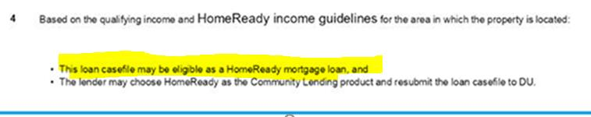
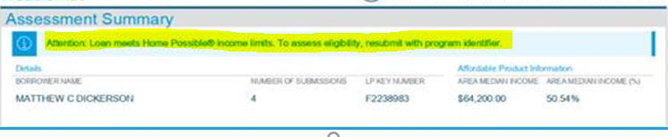
TRAINING GUIDE
Findings Are Your Friend
LP or DU will tell you on the findings if they are eligible – Review your findings!
You must rerun through the AUS as a HomeReady or HomePossible
GMFS Partners
4

Slide 5

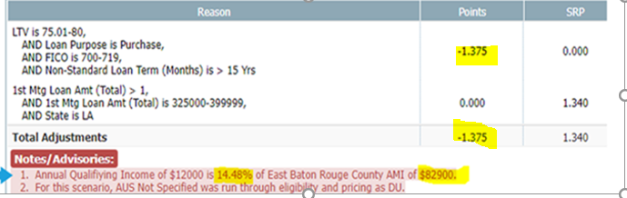
TRAINING GUIDE
Locking in OB
Make sure you are selecting the "Affordable" option on the lock request form under Product Type
Reading the notes or advisories on the Lock form also tells you if you are eligible (see note #1 below)
Anything under 80% annual qualifying income will work
GMFS Partners
5

Slide 6
PROGRAM COMPARISON
Freddie Mac Comparison
 | HomeOne | Home Possible®
Minimum FICO | 620 | 620
Max LTV | 97% | 97%
Max Ratios | Determined by LPA – usually 50% | Determined by LPA – usually 50%
Eligible Property | 1 Unit, SFR, Condo, PUD | 1 Unit, SFR, Condo, PUD
Occupancy | Primary Residence | Primary Residence
Loan Purpose | Purchase & Rate-Term Refi | Purchase & Rate-Term Refi
1st Time Buyer | Yes – 1 Borrower must be FTHB | Not limited to FTHB Only
Income Limits | None | 80% AMI – None in underserved areas
Amortization & Terms | 30 Year Fixed | 30 Year Fixed
Gifts | Allowed | Allowed
Min. Borrower Contribution | 3% | None
Non-Occupant Co-Borrowers | Not Allowed | Allowed on 1 unit property, max LTV 95%
Reserves | Determined by LPA | Determined by LPA
Own Other Property | Allowed with restrictions¹ | Allowed with no restrictions²
Mortgage Insurance | 35% | Lower than Standard MI if LTV >90%
Bankruptcy | Discharged 4 years | Discharged 4 years
Foreclosure | Settled 7 years | Settled 7 years
Seller Concessions | 3% | 3%
Home Buyer Education | Required if both Borrowers are 1st Time Buyers | Required if both Borrowers are 1st Time Buyers
Manufactured Homes | Not Allowed | Not Allowed
https://gmfspartners.com/wp-content/uploads/2021/05/convprograms_tpo_july23.pdf
GMFS Partners
6

Slide 7
PROGRAM COMPARISON
Fannie Mae Comparison
 | HomeReady® | Fannie 97
Minimum FICO | 620 | 620
Max LTV | 97% | 97%
Max Ratios | Determined by DU – usually 50% | Determined by DU – usually 50%
Eligible Property | 1 Unit, SFR, Condo, PUD | 1 Unit, SFR, Condo, PUD
Occupancy | Primary Residence | Primary Residence
Loan Purpose | Purchase & Rate-Term Refi | Purchase & Rate-Term Refi
1st Time Buyer | Not limited to FTHB Only | Yes – 1 Borrower must be FTHB
Income Limits | 80% AMI – None in underserved areas | None
Amortization & Terms | 30 Year Fixed | 30 Year Fixed
Gifts | Allowed | Allowed
Min. Borrower Contribution | None | 3%
Non-Occupant Co-Borrowers | Allowed to 95% LTV | Allowed to 95% LTV
Reserves | Determined by DU | Determined by DU
Own Other Property | Allowed with restrictions² | Allowed
Mortgage Insurance | Lower than Standard MI if LTV >90% | 35%
Bankruptcy | Discharged 4 years | Discharged 4 years
Foreclosure | Settled 7 years | Settled 7 years
Seller Concessions | 3% | 3%
Home Buyer Education | Required if both Borrowers are 1st Time Buyers | Required if both Borrowers are 1st Time Buyers
Manufactured Homes | Not Allowed | Not Allowed
https://gmfspartners.com/wp-content/uploads/2021/05/convprograms_tpo_july23.pdf
GMFS Partners
7

Slide 8
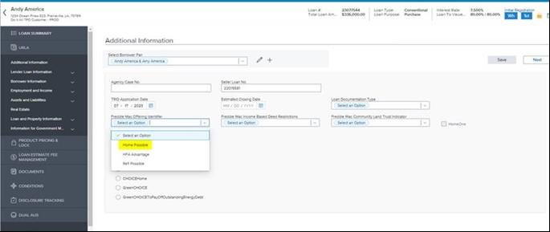
TRAINING GUIDE
How to Run in LP Through TPO Connect
Select Freddie Mac Offering indicator to select Home Possible
GMFS Partners
8

Slide 9
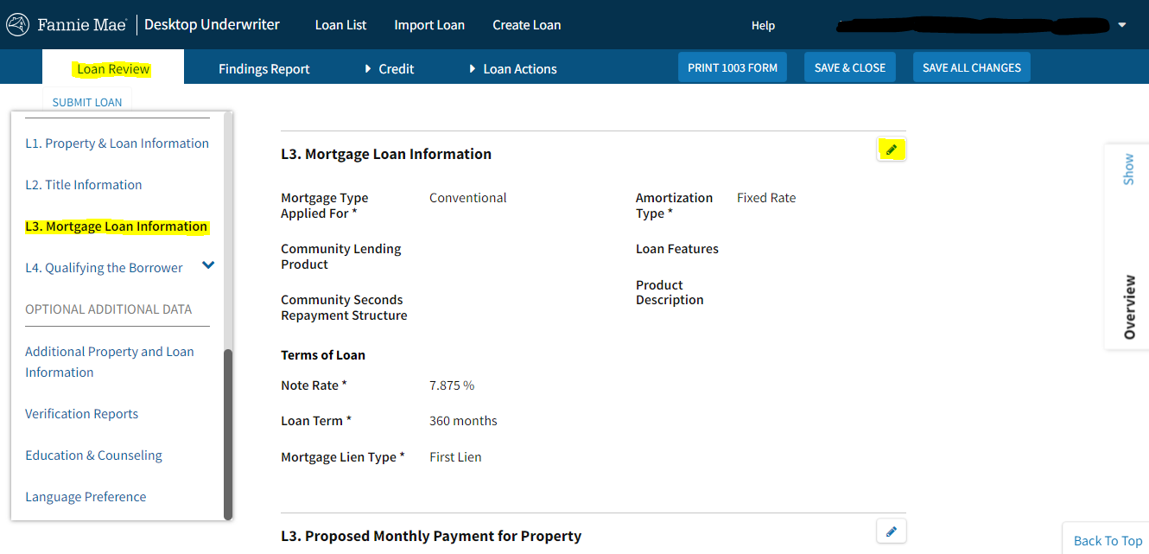
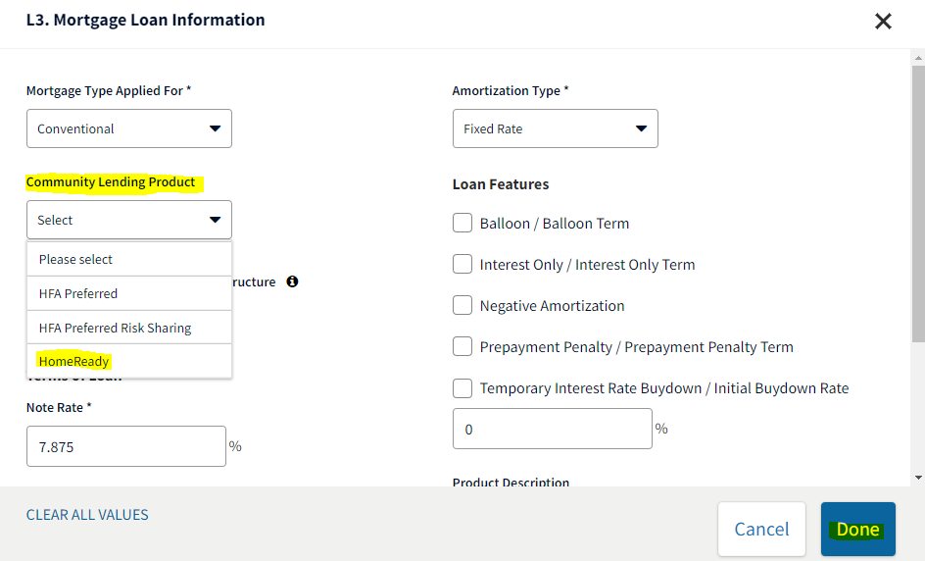
TRAINING GUIDE
Running Findings in DU for HomeReady
Begin in Section L3
Select edit, and you are met with the following box and select Community Lending Product — shown right
Select HomeReady from the dropdown — shown below
GMFS Partners
9

Slide 10
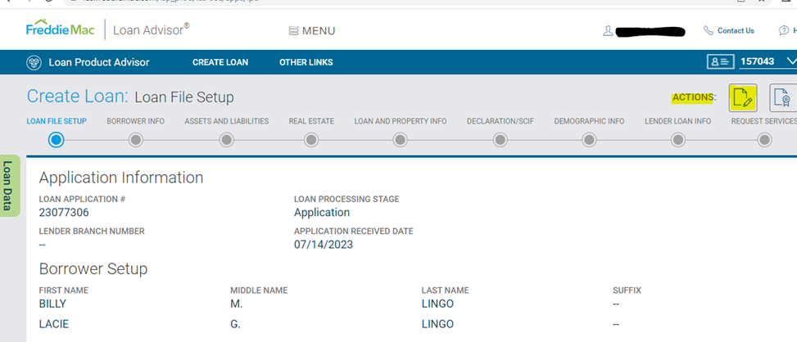
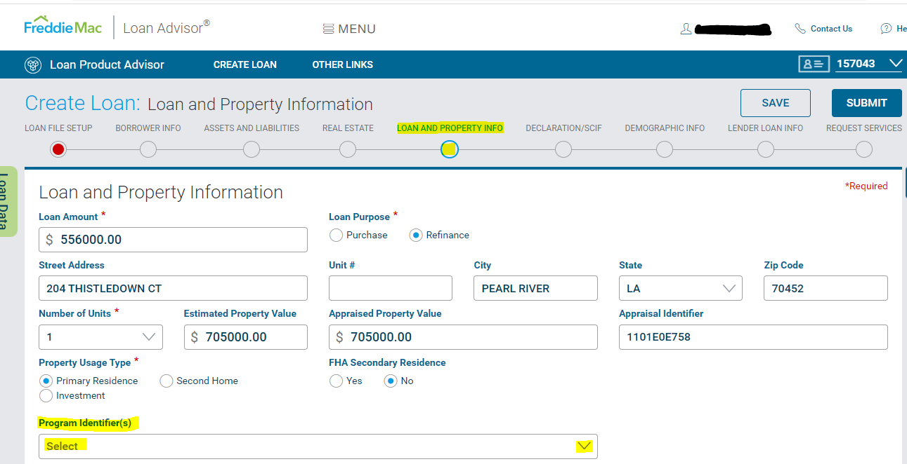
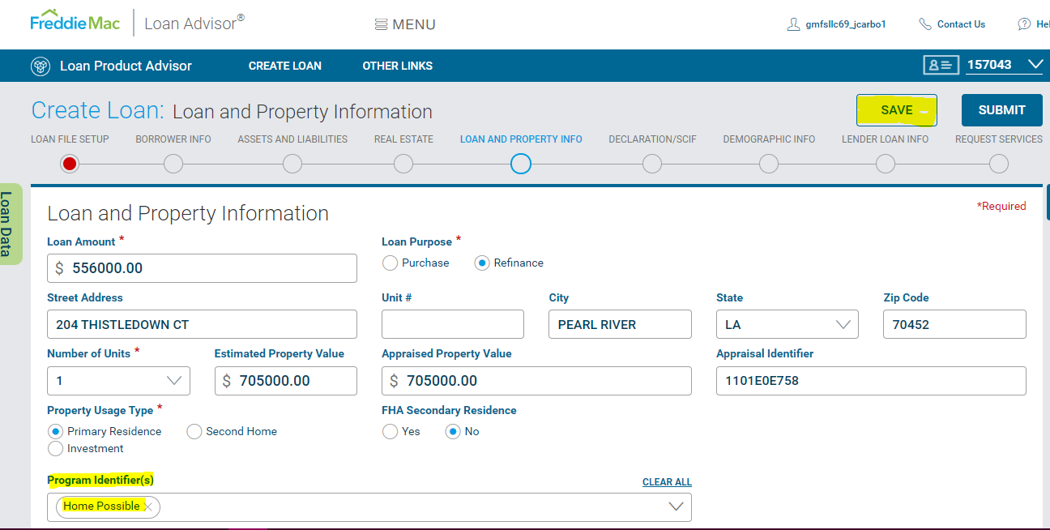
TRAINING GUIDE
Running Findings in LP Direct for Home Possible
In loan setup select 'ACTION: Modify' — shown right
Select Loan and property information, then select the Program Identifiers — shown below
GMFS Partners
10

Slide 11
PRICING
Quick Reference Pricing Grids — Waived
These fees are waived — meaningful value saved for your borrower!
Purchase Money Loans — LLPA by Credit Score / LTV Ratio
Credit Score | ≤30% | 30-60% | 60-70% | 70-75% | 75-80% | 80-85% | 85-90% | 90-95% | >95%
≥ 780 | 0.000% | 0.000% | 0.000% | 0.000% | 0.375% | 0.375% | 0.250% | 0.250% | 0.125%
760-779 | 0.000% | 0.000% | 0.000% | 0.250% | 0.625% | 0.625% | 0.500% | 0.500% | 0.250%
740-759 | 0.000% | 0.000% | 0.125% | 0.375% | 0.875% | 1.000% | 0.750% | 0.625% | 0.500%
720-739 | 0.000% | 0.000% | 0.250% | 0.750% | 1.250% | 1.250% | 1.000% | 0.875% | 0.750%
700-719 | 0.000% | 0.000% | 0.375% | 0.875% | 1.375% | 1.500% | 1.250% | 1.125% | 0.875%
680-699 | 0.000% | 0.000% | 0.625% | 1.125% | 1.750% | 1.875% | 1.500% | 1.375% | 1.125%
660-679 | 0.000% | 0.000% | 0.750% | 1.375% | 1.875% | 2.125% | 1.750% | 1.625% | 1.250%
640-659 | 0.000% | 0.000% | 1.125% | 1.500% | 2.250% | 2.500% | 2.000% | 1.875% | 1.500%
≤639¹ | 0.000% | 0.125% | 1.500% | 2.125% | 2.750% | 2.875% | 2.625% | 2.250% | 1.750%
Limited Cash-out Refinances — LLPA by Credit Score / LTV Ratio
Credit Score | ≤30% | 30-60% | 60-70% | 70-75% | 75-80% | 80-85% | 85-90% | 90-95% | >95%
≥ 780 | 0.000% | 0.000% | 0.000% | 0.125% | 0.500% | 0.625% | 0.500% | 0.375% | 0.375%
760-779 | 0.000% | 0.000% | 0.125% | 0.375% | 0.875% | 1.000% | 0.750% | 0.625% | 0.625%
740-759 | 0.000% | 0.000% | 0.250% | 0.750% | 1.125% | 1.375% | 1.125% | 1.000% | 1.000%
720-739 | 0.000% | 0.000% | 0.500% | 1.000% | 1.625% | 1.750% | 1.500% | 1.250% | 1.250%
700-719 | 0.000% | 0.000% | 0.625% | 1.250% | 1.875% | 2.125% | 1.750% | 1.625% | 1.625%
680-699 | 0.000% | 0.000% | 0.875% | 1.625% | 2.250% | 2.500% | 2.125% | 1.750% | 1.750%
660-679 | 0.000% | 0.125% | 1.125% | 1.875% | 2.500% | 3.000% | 2.375% | 2.125% | 2.125%
640-659 | 0.000% | 0.250% | 1.375% | 2.125% | 2.875% | 3.375% | 2.875% | 2.500% | 2.500%
≤639¹ | 0.000% | 0.375% | 1.750% | 2.500% | 3.500% | 3.875% | 3.625% | 2.500% | 2.500%
¹ Applicable for all loans with terms greater than 15 years.
GMFS Partners
11

Slide 12
TRAINING GUIDE
Links and Resources
AMI Lookup Tool
ami-lookup-tool.fanniemae.com
Fannie Mae
singlefamily.fanniemae.com — HomeReady mortgage
Grids — singlefamily.fanniemae.com/media/9391
Freddie Mac
sf.freddiemac.com — Home Possible
GMFS Partners
12

